Slide 1


Slide 2

PROJECT OVERVIEW

Slide 3

PROJECT OVERVIEW
The objective of this case study is to forecast weekly retail store sales based on historical data.
This dataset contains weekly sales from 99 departments belonging to 45 different stores.
The data contains holidays and promotional markdowns offered by various stores and several departments throughout the year .
Markdowns are crucial to promote sales especially before key events such as Super Bowl, Christmas and Thanksgiving.
Developing accurate model will enable make informed decisions and make recommendations to improve business processes in the future.
The data consists of three sheets:
Stores
Features
Sales
Data Source : https://www.kaggle.com/manjeetsingh/retaildataset

Slide 4
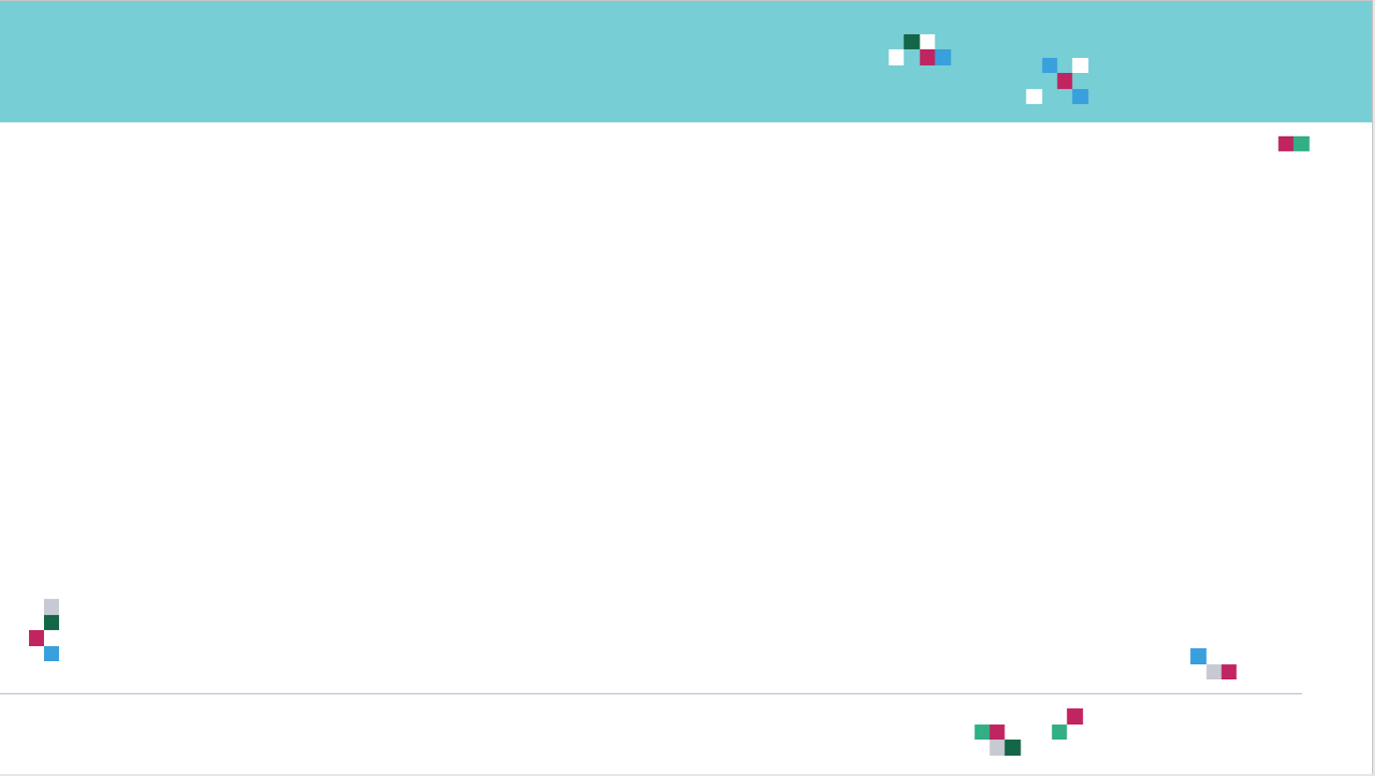
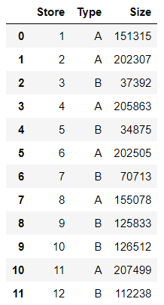
PROJECT OVERVIEW
1. Stores: information about 45 stores such as type and size of store.

Slide 5
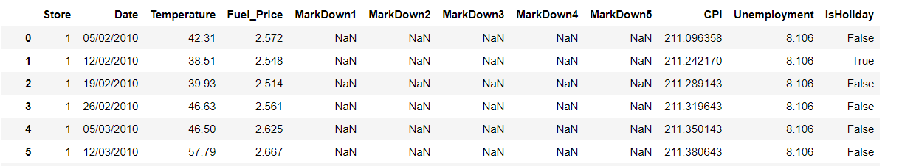
PROJECT OVERVIEW
2. Features: additional data related to the store, department, and regional activity for the given dates.
Store: store number
Date: week
Temperature: average temperature in the region
Fuel_Price: cost of fuel in the region
MarkDown1-5: anonymized data related to promotional markdowns.
CPI: consumer price index
Unemployment: unemployment rate
IsHoliday: whether the week is a special holiday week

Slide 6
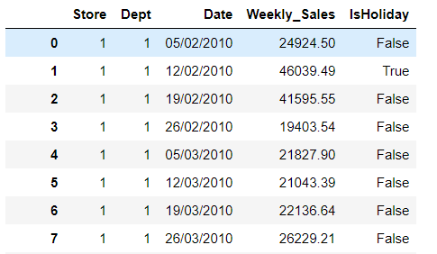
PROJECT OVERVIEW
3. Sales: Historical sales data, which covers 2010-02-05 to 2012-11-01.
Store: store number
Dept: department number
Date: the week
Weekly_Sales: sales for the given department in the given store
IsHoliday: whether the week is a special holiday week

Slide 7
BASICS: BIAS VARIANCE TRADE-OFF

Slide 8
BIAS VARIANCE INTUITION
Let’s assume that we want to get the relationship between the Temperature and weekly sales.
As temperature increase, people tend to be happier and shop more.
This will likely increase the weekly sales.
As temperature goes beyond a certain limit, sales tend to plateau and they do not increase anymore.
PERFECT (TRUE) MODEL!
WEEKLY SALES
TEMPERATURE

Slide 9
BIAS VARIANCE TRAINING VS. TESTING DATASETS
Dataset is divided to training and testing datasets
Testing datasets have never been seen by the model before
WEEKLY SALES
TESTING DATASET
TRAINING DATASET
TEMPERATURE

Slide 10
BIAS AND VARIANCE: MODEL #1– LINEAR REGRESSION (SIMPLE)
Linear Regression model uses a straight line to fit the training dataset
Linear regression model lacks flexibility so it cannot properly fit the data (as the true perfect model does!)
The linear model has a large “bias” which indicates that the model is unable to accurately capture the true relationship between temperature and weekly sales.
PERFECT (TRUE) MODEL!
WEEKLY SALES
LINEAR REGRESSION MODEL
TRAINING DATASET
TEMPERATURE

Slide 11
BIAS AND VARIANCE: MODEL #2 – HIGH ORDER POLYNOMIAL REGRESSION (COMPLEX)
PERFECT (TRUE) MODEL!
High order polynomial model is able to have a very small bias and can perfectly fit the training dataset.
High-order polynomial model is very flexible
WEEKLY SALES
HIGH ORDER POLYNOMIAL MODEL
TRAINING DATASET
TEMPERATURE

Slide 12


BIAS AND VARIANCE: MODEL #1 Vs. MODEL #2 DURING TRAINING
PERFECT (TRUE) MODEL!
PERFECT (TRUE) MODEL!
WEEKLY SALES
WEEKLY SALES
LINEAR REGRESSION MODEL
HIGH ORDER POLYNOMIAL MODEL
TEMPERATURE
TEMPERATURE
SUM OF SQUARES (LARGE)
SUM OF SQUARES (SMALL ~0)
THIS IS NOT THE WHOLE STORY!!

Slide 13
BIAS AND VARIANCE: MODEL #1 Vs. MODEL #2 DURING TESTING
PERFECT (TRUE) MODEL!
PERFECT (TRUE) MODEL!
WEEKLY SALES
WEEKLY SALES
LINEAR REGRESSION MODEL
HIGH ORDER POLYNOMIAL MODEL
TEMPERATURE
TEMPERATURE
SUM OF SQUARES (SMALL)
SUM OF SQUARES (LARGE)
The polynomial model performs poorly on the testing dataset and therefore it has large variance

Slide 14
MODEL COMPLEXITY VS. ERROR
OPTIMUM MODEL
Regularization works by reducing the variance at the cost of adding some bias to the model.
A trade-off between variance and bias occurs.
TOTAL ERROR
VARIANCE
ERROR
BIAS
MODEL COMPLEXITY
LINEAR
POLYNOMIAL

Slide 15
MODEL COMPLEXITY VS. ERROR
MODEL #1 (LINEAR REGRESSION) (SIMPLE) | MODEL #2 (HIGH ORDER POLYNOMIAL) (COMPLEX)
Model has High bias because it is very rigid (not flexible) and cannot fit the training dataset well | Model has small bias because it is flexible and can fit the training dataset very well.
Has small variance (variability) because it can fit the training data and the testing data with similar level (the model is able to generalize better) and avoids overfitting | Has large variance (variability) because the model over fitted the training dataset and it performs poorly on the testing dataset
Performance is consistent between the training dataset and the testing dataset | Performance varies greatly between the training dataset and the testing dataset (high variability)
Good generalization | Over fitted
Variance measures the difference in fits between the training dataset and the testing dataset
If the model generalizes better, the model has small variance which means the model performance is consistent among the training and testing datasets
If the model over fits the training dataset, the model has large variance
PERFECT REGRESSION MODEL SHALL HAVE SMALL BIAS AND SMALL VARIABILITY!
A TRADEOFF BETWEEN THE BIAS AND VARIANCE SHALL BE PERFORMED FOR ULTIMATE RESULTS

Slide 16
BASICS: L2 REGULARIZATION
(RIDGE REGRESSION)

Slide 17

REGULARIZATION: INTUITION
Regularization techniques are used to avoid networks overfitting
Overfitting occurs when the model provide great results on the training data but performs poorly on testing dataset.
Overfitting occurs when the model learns all the patterns of the training dataset but fails to generalize.
Overfitted models generally provide high accuracy on training dataset but low accuracy on testing and validation (evaluation) datasets
Photo Credit: https://commons.wikimedia.org/wiki/File:Overfitted_Data.png

Slide 18
RIDGE REGRESSION (L2 REGULARIZATION): INTUITION
Ridge regression advantage is to avoid overfitting.
Our ultimate model is the one that could generalize patterns; i.e.: works best on the training and testing dataset
Overfitting occurs when the trained model performs well on the training data and performs poorly on the testing datasets
Ridge regression works by applying a penalizing term (reducing the weights and biases) to overcome overfitting.
OVERFITTED MODEL
WEEKLY SALES
BALANCED/GENERAL MODEL
TEMPERATURE

Slide 19
RIDGE REGRESSION (L2 REGULARIZATION): INTUITION
Least sum of squares is applied to obtain the best fit line
Since the line passes through the 3 training dataset points, the sum of squared residuals = 0
However, for the testing dataset, the sum of residuals is large so the line has a high variance.
Variance means that there is a difference in fit (or variability) between the training dataset and the testing dataset.
This regression model is overfitting the training dataset
WEEKLY SALES
TRAINING
DATASET
TESTING DATASET
TEMPERATURE

Slide 20
RIDGE REGRESSION (L2 REGULARIZATION): INTUITION
Ridge regression works by attempting at increasing the bias to improve variance (generalization capability)
This works by changing the slope of the line
The model performance might be little poor on the training set but it will perform consistently well on both the training and testing datasets.
RIDGE REGRESSION
TRAINING DATASET
LEAST SQUARES REGRESSION
WEEKLY SALES
TESTING DATASET
TEMPERATURE

Slide 21
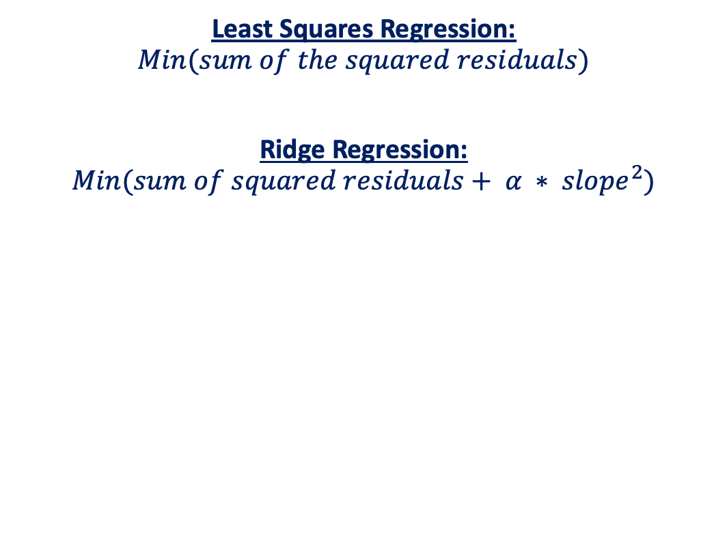
RIDGE REGRESSION (L2 REGULARIZATION): MATH
Slope has been reduced with ridge regression penalty and therefore the model becomes less sensitive to changes in the independent variable (temperature)
RIDGE REGRESSION
LEAST SQUARES REGRESSION
PENALTY TERM
WEEKLY SALES
Least Squares Regression:
$$Min(sum of the squared residuals)$$
Ridge Regression:
$$Min(sum of squared residuals+ α ∗ slope^{2})$$
TEMPERATURE

Slide 22
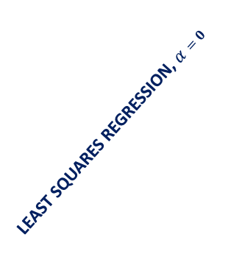

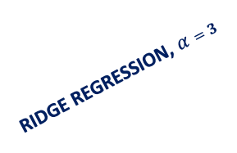
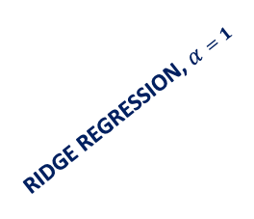
RIDGE REGRESSION (L2 REGULARIZATION): ALPHA EFFECT
As Alpha increases, the slope of the regression line is reduced and becomes more horizontal.
As Alpha increases, the model becomes less sensitive to the variations of the independent variable (Temperature)
RIDGE REGRESSION, $α=1$
LEAST SQUARES REGRESSION, $α=0$
RIDGE REGRESSION, $α=3$
WEEKLY SALES
RIDGE REGRESSION, $α=10$
TEMPERATURE

Slide 23
BASICS: L1 REGULARIZATION
(LASSO REGRESSION )

Slide 24
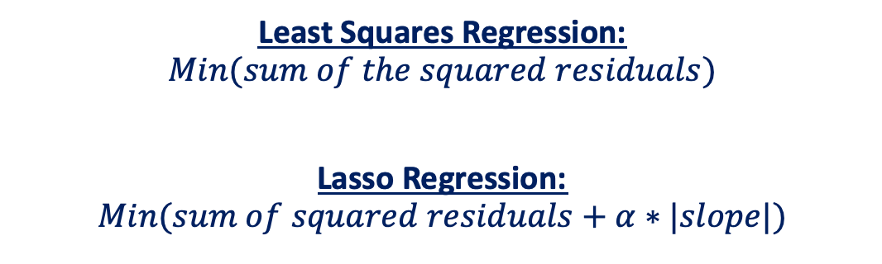
LASSO REGRESSION (L1 REGULARIZATION): MATH
Lasso Regression is similar to Ridge regression
It works by introducing a bias term but instead of squaring the slope, the absolute value of the slope is added as a penalty term
LASSO REGRESSION
LEAST SQUARES REGRESSION
PENALTY TERM
Least Squares Regression:
$$Min(sum of the squared residuals)$$
Lasso Regression:
$$Min(sum of squared residuals+α∗|slope|)$$
WEEKLY SALES
TEMPERATURE

Slide 25
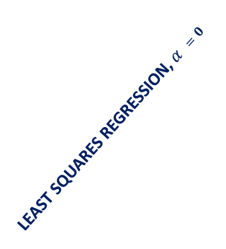

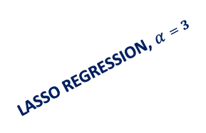
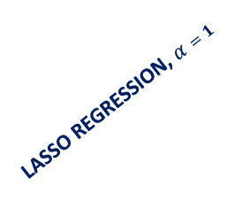
LASSO REGRESSION (L1 REGULARIZATION)
The effect of Alpha on Lasso regression is similar to its effect on ridge regression
As Alpha increases, the slope of the regression line is reduced and becomes more horizontal.
As Alpha increases, the model becomes less sensitive to the variations of the independent variable (Temperature)
LASSO REGRESSION, $α=1$
LEAST SQUARES REGRESSION, $α =0$
LASSO REGRESSION, $α=3$
LASSO REGRESSION, $α=10$
WEEKLY SALES
TEMPERATURE

Slide 26
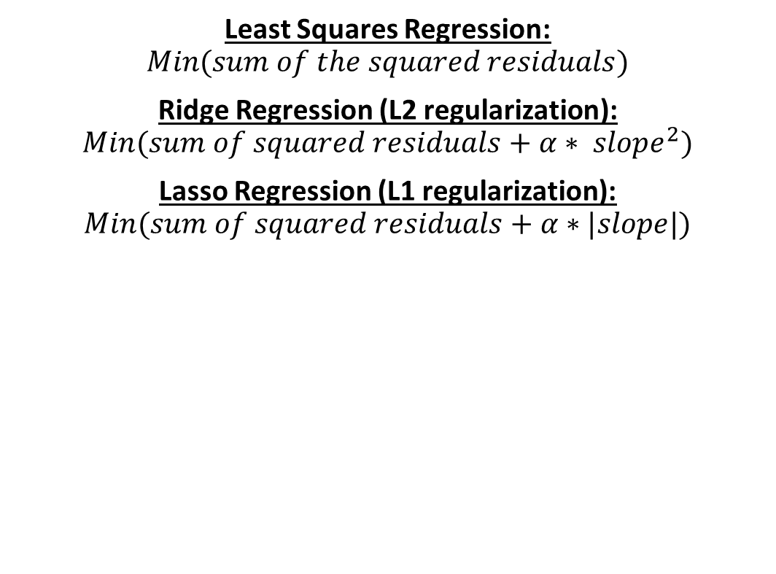
LASSO REGRESSION: MATH
Lasso regression (L1 regularization) helps reduce overfitting and it is particularly useful for feature selection
Lasso regression (L1 regularization) can be useful if we have several independent variables that are useless
Ridge regression can reduce the slope close to zero (but not exactly zero) but Lasso regression can reduce the slope to be exactly equal to zero.
Least Squares Regression:
$$Min(sum of the squared residuals)$$
Ridge Regression (L2 regularization):
$$Min(sum of squared residuals+α∗ slope^{2})$$
Lasso Regression (L1 regularization):
$$Min(sum of squared residuals+α∗|slope|)$$

Slide 27
IN SUMMARY
L1 Regularization | L2 regularization
Used to perform feature selection so some features are allowed to go to zero | All features are maintained, but weighted accordingly. No features are allowed to go to zero
When to choose L1?
If you believe that some features are not important and you can afford to lose them, then L1 regularization is a good choice.
The output might become sparse since some features might have been removed.
When to choose L2?
If you believe that all features are important and you’d like to keep them but weigh them accordingly.

Slide 28
XGBOOST – INTRODUCTION

Slide 29

XGBOOST: INTRODUCTION
XGBoost or Extreme gradient boosting is the algorithm of choice for many data scientists and could be used for regression and classification tasks.
XGBoost is a supervised learning algorithm and implements gradient boosted trees algorithm.
The algorithm work by combining an ensemble of predictions from several weak models.
It is robust to many data distributions and relationships and offers many hyperparameters to tune model performance.
Xgboost offers increased speed and enhanced memory utilization.
Xgboost is analogous to the idea of “discovering truth by building on previous discoveries”.
"If I have seen further it is by standing on the shoulders of Giants”, Isaac Newton
This picture is derived from Greek mythology: the giant Orion carried his servant Cedalion on his shoulders to act as the giant's eyes.
Source: https://commons.wikimedia.org/wiki/File:Library_of_Congress,_Rosenwald_4,_Bl._5r.jpg

Slide 30
ADVANTAGES AND DISADVANTAGES OF XGBOOST
ADVANTAGES:
No need to perform any feature scaling
Can work well with missing data
Robust to outliers in the data
Can work well for both regression and classification
Computationally efficient and produce fast predictions
Works with distributed training: AWS can distribute the training process and data on many machines
DISADVANTAGES:
Poor extrapolation characteristics
Need extensive tuning
Slow training

Slide 31
DISADVANTAGES OF XGBOOST: POOR EXTRAPOLATION CAPABILITY BY XGBOOST
Out of bound inference with XGBoost will cause issues and result in unreasonable predictions
LINEAR REGRESSION
& ARTIFICIAL NEURAL NETWORKS
XGBOOST
& RANDOM FOREST
AGE
AGE
MODEL PREDICTIONS (INFERENCE)
TRAINING DATA
SAVINGS
SAVINGS

Slide 32
XGBOOST – WHAT IS BOOSTING?

Slide 33
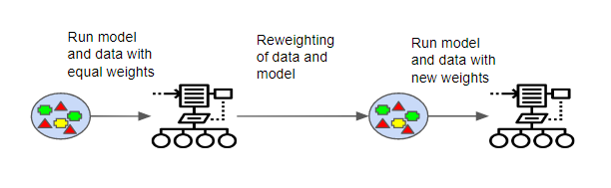
XGBOOST: WHAT IS BOOSTING?
Boosting works by learning from previous mistakes (errors in model predictions) to come up with better future predictions.
Boosting is an ensemble machine learning technique that works by training weak models in a sequential fashion.
Each model is trying to learn from the previous weak model and become better at making predictions.
Boosting algorithms work by building a model from the training data, then the second model is built based on the mistakes (residuals) of the first model. The algorithm repeats until the maximum number of models have been created or until the model provides good predictions.
Great Resource: https://medium.com/greyatom/a-quick-guide-to-boosting-in-ml-acf7c1585cb5
Photo Credit: https://commons.wikimedia.org/wiki/File:Boosting.png

Slide 34
XGBOOST: BOOSTING EXAMPLE
Model #1 works by attempting to classify the two classes (+) and (-) with the vertical line shown.
Model #1 has assigned equal weights to all data points since it has no prior knowledge or experience from before.
Model #1 misclassified 3 (+) samples.

Slide 35
XGBOOST: BOOSTING EXAMPLE
Model #2 learns from the mistakes of the previous model and assigns more weight to the wrongly classified data points (3 +) as shown in the figure below.
So model #2 draws a vertical separating line and “made sure” to properly classify these points this time!
The model did a great job correctly classifying points with higher weights but in the process, it has misclassified two red (-) samples.

Slide 36
XGBOOST: BOOSTING EXAMPLE
Model #3 learns from the mistakes of the previous model and assigns more weight to the wrongly classified data points (2 -) as shown in the figure below.
So model #3 draws a horizontal separating line and “made sure” to properly classify these points this time!
The model did a great job correctly classifying points with higher weights but in the process, it has misclassified two blue (+) samples.

Slide 37
XGBOOST: BOOSTING EXAMPLE
Model #4 combines all the mistakes from all these weak models to build a much stronger model that correctly classifies all data points.

Slide 38
XGBOOST – WHAT ARE DECISION TREES & ENSEMBLE LEARNING?

Slide 39
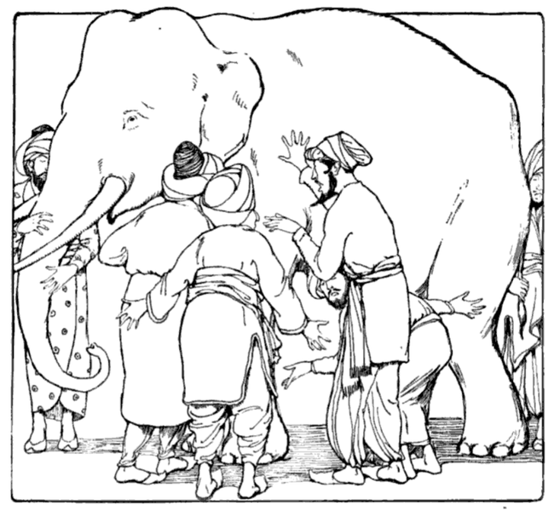
XGBOOST: WHAT IS ENSEMBLE LEARNING?
XGBoost is an example of ensemble learning.
Ensemble techniques such as bagging and boosting can offer an extremely powerful algorithm by combining a group of relatively weak/average ones.
For example, you can combine several decision trees to create a powerful random forest algorithm.
By Combining votes from a pool of experts, each will bring their own experience and background to solve the problem resulting in a better outcome.
Boosting can reduce variance and overfitting and increase the model robustness.
Example: Blind men and the elephant
Model #1
Model #2
Model #3
VOTING
Photo Credit: https://commons.wikimedia.org/wiki/File:Blind_men_and_elephant.png

Slide 40
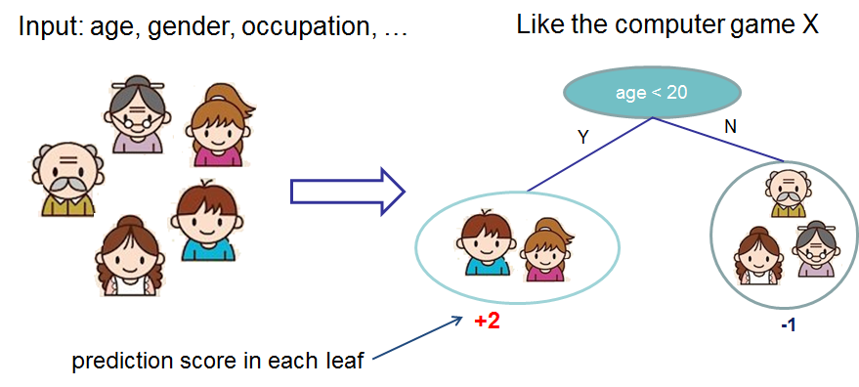
XGBOOST: DECISION TREES ENSEMBLES
Decision Trees are supervised Machine Learning technique where data is split according to a certain condition/parameter.
The tree consists of decision nodes and leaves.
Leaves are the decisions or the final outcomes.
Decision nodes are where the data is split based on a certain attribute.
The tree ensemble model consists of a set of classification and regression trees (CART).
A CART that classifies whether an individual will like a computer game X or not is shown below.
Members of the family are divided into leaves and a score is assigned to each leaf.
DECISION NODES
Source: https://xgboost.readthedocs.io/en/latest/tutorials/model.html
LEAVES

Slide 41
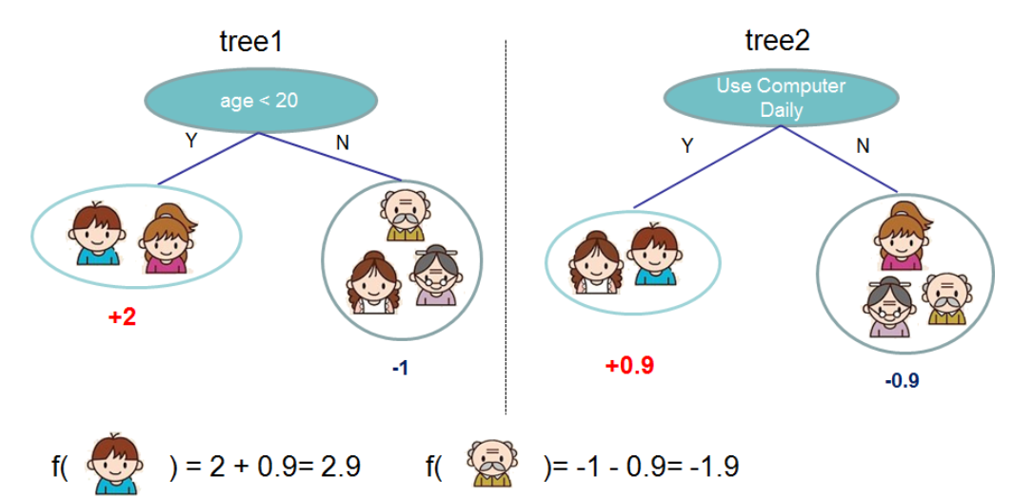
XGBOOST: DECISION TREES ENSEMBLES
Ensemble models that combines the predictions from all trees is built as shown below.
The prediction scores of each individual tree are summed up to get the final score.
Source: https://xgboost.readthedocs.io/en/latest/tutorials/model.html

Slide 42
XGBOOST – DEEPDIVE

Slide 43
XGBOOST: STEPS
XGBoost repeatedly builds new models and combine them into an ensemble model
Initially build the first model and calculate the error for each observation in the dataset
Then you build a new model to predict those residuals (errors)
Then you add prediction from this model to the ensemble of models
XGboost is superior compared to gradient boosting algorithm since it offers a good balance between bias and variance (Gradient boosting only optimized for the variance so tend to overfit training data while Xgboost offers regularization terms that can improve model generalization).
BUILD A MODEL TO PREDICT THOSE ERRORS
INITIAL MODEL (STARTING POINT)
CALCULATE THE ERRORS BASED ON THE PREVIOUS MODEL (RESIDUALS)
ADD LAST MODEL TO THE ENSEMBLE

Slide 44
XGBOOST: GRADIENT BOOSTING ALGORITHM
INITIAL GUESS (AVERAGE)
Y
N
Learning Rate
Y
N
Y
N
Y
N
LEARNING RATE
Y
N
Y
N
SCALING FACTOR
Y
N
LEARNING RATE
Y
N
Y
N

Slide 45
XGBOOST: GRADIENT BOOSTING ALGORITHM
Gradient boost works by building a tree based on the error (residuals) from the previous tree.
Gradient boost scales the trees and then adds the predictions from the new tree to the predictions from previous trees.
Example adopted from the awesome StatQuest (by Josh Starmer): https://www.youtube.com/watch?v=3CC4N4z3GJc&t=87s
Height | Color | Gender | Weight (Kg)
1.6 | Blue | Male | 88
1.6 | Green | Female | 76
1.5 | Blue | Female | 56
1.8 | Red | Male | 73
1.5 | Green | Male | 77
1.4 | Blue | Female | 57
VARIABLE TO BE PREDICTED
INPUT FEATURES

Slide 46
XGBOOST: GRADIENT BOOSTING ALGORITHM
Let’s assume that the initial model predictions (starting point) is the average weight is 71.2
Gradient boost builds a tree based on the error from the first tree.
The tree is built by assuming that the features (heights, color, and gender) predicts the residuals (new column that we have just created).
71.2
INITIAL STARTING POINT (PREDICTIONS)
Height | Color | Gender | Weight (Kg)
1.6 | Blue | Male | 88
1.6 | Green | Female | 76
1.5 | Blue | Female | 56
1.8 | Red | Male | 73
1.5 | Green | Male | 77
1.4 | Blue | Female | 57
Error = True – predicted
88-71.2=16.8
76-71.2=4.8
56-71.2=-15.2
73-71.2=1.8
77-71.2=5.8
57-71.2=-14.2
Is female?
Y
N
Height <1.6
Is not Blue?
Y
N
Y
N
-15.2,
-14.2
4.8
1.8, 5.8
16.8
ERRORS (RESIDUALS)
Example adopted from the awesome StatQuest (by Josh Starmer): https://www.youtube.com/watch?v=3CC4N4z3GJc&t=87s
INPUT FEATURES

Slide 47
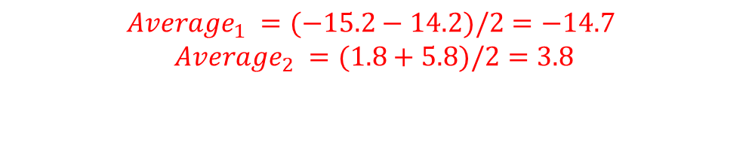
XGBOOST: GRADIENT BOOSTING ALGORITHM
Note that the number of leaves is restricted to 4 in this example for the sake of simplicity.
Let’s replace the values with the average a shown below.
Is female?
Is female?
Y
N
Y
N
Height <1.6
Is not Blue?
Height <1.6
Is not Blue?
Y
N
Y
N
Y
N
Y
N
-15.2,
-14.2
4.8
1.8, 5.8
16.8
-14.7
4.8
3.8
16.8
$$Average_{1} =(−15.2−14.2)/2=−14.7$$
$$Average_{2} =(1.8+5.8)/2=3.8$$
Example adopted from the awesome StatQuest (by Josh Starmer): https://www.youtube.com/watch?v=3CC4N4z3GJc&t=87s

Slide 48
XGBOOST: GRADIENT BOOSTING ALGORITHM
Now that we have built a tree, let’s combine the previous predictions with the new tree to generate new predictions!
Is female?
Y
N
71.2
Height <1.6
Is not Blue?
AVERAGE WEIGHT (INITIAL GUESS FROM PREVIOUS STEP
Y
N
Y
N
-14.7
4.8
1.8, 5.8
16.8
The model predictions match the true weight. This indicates that the model is overfitting the training data
Height | Color | Gender | Weight (Kg)
1.6 | Blue | Male | 88
1.6 | Green | Female | 76
1.5 | Blue | Female | 56
1.8 | Red | Male | 73
1.5 | Green | Male | 77
1.4 | Blue | Female | 57
New predictions
88
Predictions = 71.2+16.8=88
Example adopted from the awesome StatQuest (by Josh Starmer): https://www.youtube.com/watch?v=3CC4N4z3GJc&t=87s

Slide 49
XGBOOST: GRADIENT BOOSTING ALGORITHM
We add a learning rate (range from 0 to 1) to overcome this issue.
This parameter is used for scaling purposes by adjusting the newly added information from the new tree.
Adding this tree and scaling it with the learning rate helps us get a little closer to the true values.
By taking smaller steps, the model results in better predictions on the testing dataset (low variance).
Is female?
71.2
Y
N
LEARNING RATE 0.1
Height <1.6
Is not Blue?
AVERAGE WEIGHT (INITIAL GUESS FROM PREVIOUS STEP
Y
N
Y
N
-14.7
4.8
1.8, 5.8
16.8
Height | Color | Gender | Weight (Kg)
1.6 | Blue | Male | 88
1.6 | Green | Female | 76
1.5 | Blue | Female | 56
1.8 | Red | Male | 73
1.5 | Green | Male | 77
1.4 | Blue | Female | 57
New predictions
72.9
Predictions = 71.2+ 0.1 * 16.8=72.9

Slide 50
XGBOOST: GRADIENT BOOSTING ALGORITHM
Now let’s build another tree with the new residuals from the new predictions.
Initial Residuals
16.8
4.8
-15.2
1.8
5.8
-14.2
RECALL THAT THESE ARE THE INITIAL RESIDUALS
Predictions = 71.2+ 0.1 * 16.8=72.9
RESIDUALS HAVE GONE DOWN!
Height | Color | Gender | Weight (Kg)
1.6 | Blue | Male | 88
1.6 | Green | Female | 76
1.5 | Blue | Female | 56
1.8 | Red | Male | 73
1.5 | Green | Male | 77
1.4 | Blue | Female | 57
New predictions | New Residuals
72.9 | 88-72.9 = 15.1
 | 4.3
 | -13.7
 | 1.4
 | 5.4
 | -12.7

Slide 51
XGBOOST: GRADIENT BOOSTING ALGORITHM
Is female?
71.2
Y
N
LEARNING RATE 0.1
Height <1.6
Is not Blue?
AVERAGE WEIGHT (INITIAL GUESS FROM PREVIOUS STEP
Y
N
Y
N
-14.7
4.8
1.8, 5.8
16.8
Is female?
NOW YOU CAN MAKE NEW PREDICTIONS BY COMBINING ALL THE SCALED PREDICTIONS FROM ALL TREES
Y
N
LEARNING RATE 0.1
Height <1.6
Is not Blue?
Y
N
Y
N
Is female?
Y
N
LEARNING RATE 0.1
Height <1.6
Is not Blue?
Y
N
Y
N

Slide 52
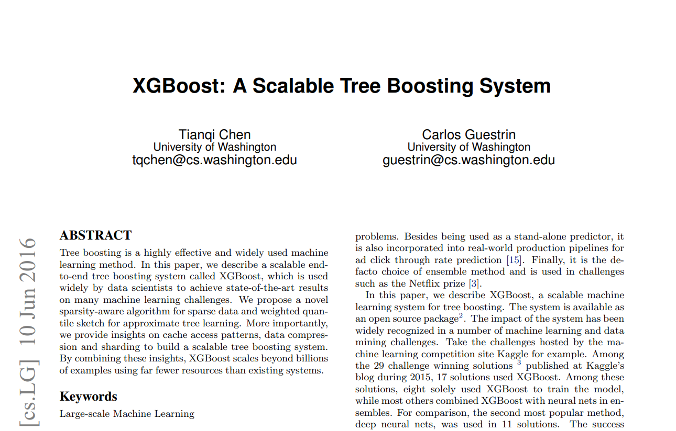
XGBOOST: WHAT IS THE EXTREME GRADIENT BOOSTING THEN? GREAT RESOURCES
Paper: https://arxiv.org/pdf/1603.02754.pdf
https://xgboost.readthedocs.io/en/latest/tutorials/model.html

Slide 53
XGBOOST: PAPER HIGHLIGHTS
“The most important factor behind the success of XGBoost is its scalability in all scenarios. The system runs more than ten times faster than existing popular solutions on a single machine and scales to billions of examples in distributed or memory-limited settings.”
“The scalability of XGBoost is due to several important systems and algorithmic optimizations. These innovations include: a novel tree learning algorithm is for handling sparse data; a theoretically justified weighted quantile sketch procedure enables handling instance weights in approximate tree learning. Parallel and distributed computing makes learning faster which enables quicker model exploration”.
“More importantly, XGBoost exploits out-of-core computation and enables data scientists to process hundred millions of examples on a desktop”.
“Finally, it is even more exciting to combine these techniques to make an end-to-end system that scales to even larger data with the least amount of cluster resources”.
Paper: https://arxiv.org/pdf/1603.02754.pdf

Slide 54
AWS SAGEMAKER XGBOOST

Slide 55
SAGEMAKER XGBOOST: OVERVIEW
Recently, XGBoost is the go to algorithm for most developers and has won several Kaggle competitions.
Why does Xgboost work really well?
Since the technique is an ensemble algorithm, it is very robust and could work well with several data types and complex distributions.
Xgboost has a many tunable hyperparameters that could improve model fitting.
What are the applications of XGBoost?
XGBoost could be used for fraud detection to detect the probability of a fraudulent transactions based on transaction features.

Slide 56

SAGEMAKER XGBOOST: INPUT/OUTPUT DATA
Gradient boosting uses tabular data for inputs/outputs:
Rows represent observations,
One column represents the output or target label
The rest of the columns represent the inputs (features)
Amazon SageMaker implementation of XGBoost supports the following file format for training and inference :
CSV
libsvm
Xgboost does not support protobuf format (note: this is unique compared to other Amazon SageMaker algorithms, which use the protobuf training input format).

Slide 57

SAGEMAKER XGBOOST: EC2 INSTANCE
XGBoost currently only trains using CPUs.
XGboost is memory intensive algorithm so it does not require much compute.
M4: General-purpose compute instance is recommended.

Slide 58

SAGEMAKER XGBOOST: HYPERPARAMETERS
There is over 40 hyperparameters to tune Xgboost algorithm with AWS SageMaker
Here’re the tree most important ones:
Max_depth (0 – inf): is critical to ensure that you have the right balance between bias and variance. If the max_depth is set too small, you will underfit the training data. If you increase the max_depth, the model will become more complex and will overfit the training data. Default value is 6.
Gamma (0 – inf): Minimum loss reduction needed to add more partitions to the tree.
Eta (0 – 1): step size shrinkage used in update to prevents overfitting and make the boosting process more conservative. After each boosting step, you can directly get the weights of new features, and eta shrinks the feature weights.
Alpha: L1 regularization term on weights. regularization term to avoid overfitting. The higher the gamma the higher the regularization. If gamma is set to zero, no regularization is put in place.
Lambda: L2 regularization
Check out the rest of hyperparameters here: https://docs.aws.amazon.com/sagemaker/latest/dg/xgboost_hyperparameters.html

Slide 59
STEPS TO PERFORM HYPERPARAMETERS OPTIMIZATION IN SAGEMAKER

Slide 60
HYPERPARAMETERS TUNING
HYPERPARAMETER
PARAMETER
Parameter: values that are obtained by the training process such as network weights and biases.
Hyper parameter: values set prior to the training process such as number of neurons, layers, learning rate..etc
Selecting the best hyperparameter values (via optimization) is an extremely challenging task.

Slide 61
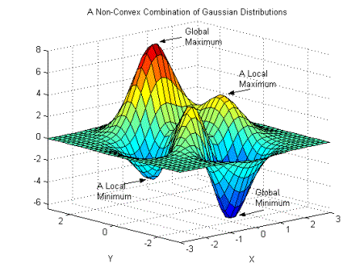
EXAMPLE: LEARNING RATE
An important parameter used during training is known as the “learning rate”.
Learning rate is a hyperparameter that represents the size of the steps taken which indicates how aggressive you’d like to update the parameters.
If learning rate increases, the area covered in the search space will increase so we might reach global minimum faster.
However, we can overshoot the target.
For small learning rates, training will take much longer to reach optimized weight values
Photo Credit: https://commons.wikimedia.org/wiki/File:Non-Convex_Objective_Function.gif

Slide 62

HYPERPARAMETERS OPTIMIZATION STEPS IN SAGEMAKER
It should look like this :

Slide 63
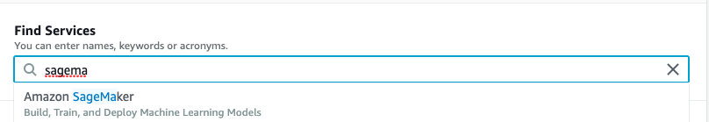
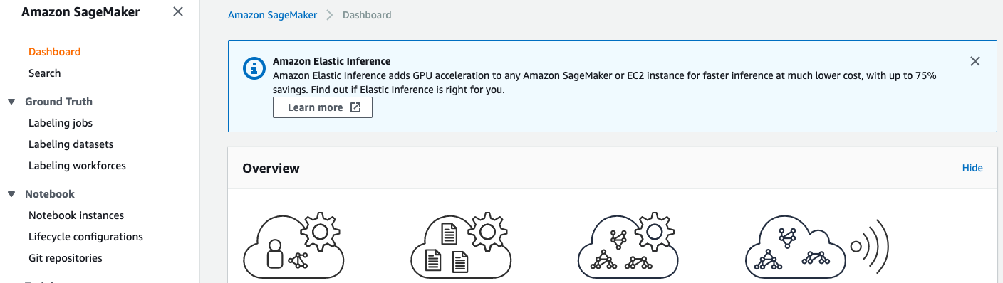
HYPERPARAMETERS OPTIMIZATION STEPS IN SAGEMAKER
Under Find Services, type and click on Amazon Sagemaker.
Click on the Hyper-parameter Tuning Instances

Slide 64
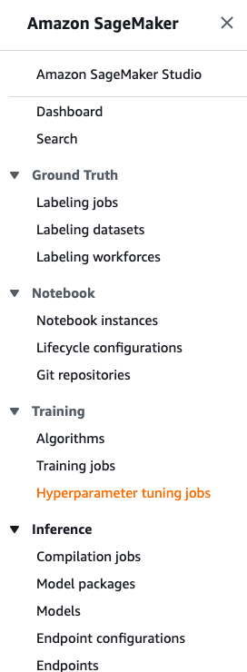
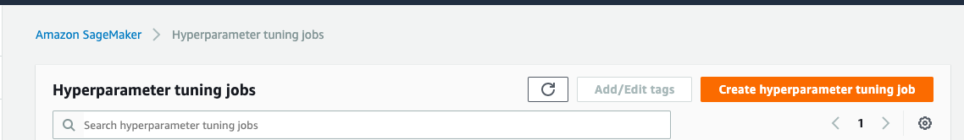
HYPERPARAMETERS OPTIMIZATION STEPS IN SAGEMAKER
Step 2: Click on this to create a hyperparameter tuning job
Step 1: Click on this

Slide 65
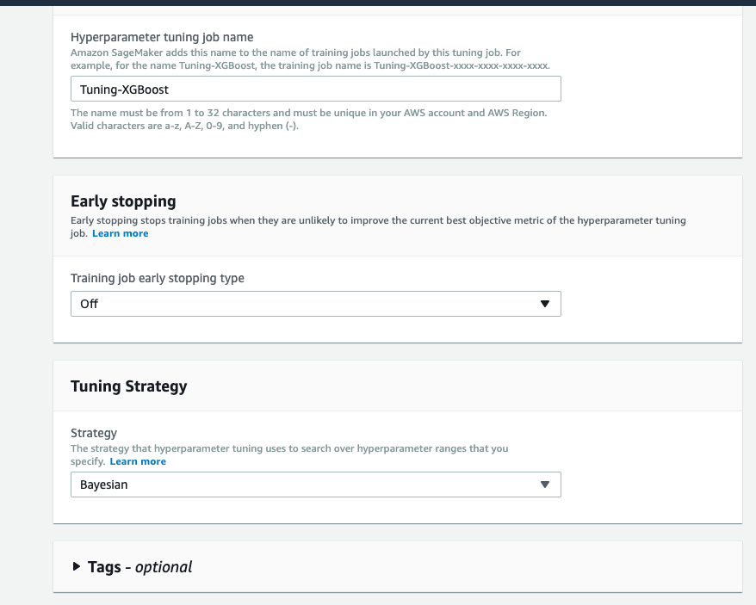
HYPERPARAMETERS OPTIMIZATION STEPS IN SAGEMAKER
Provide the name for tuning job name
Select Bayesian strategy

Slide 66
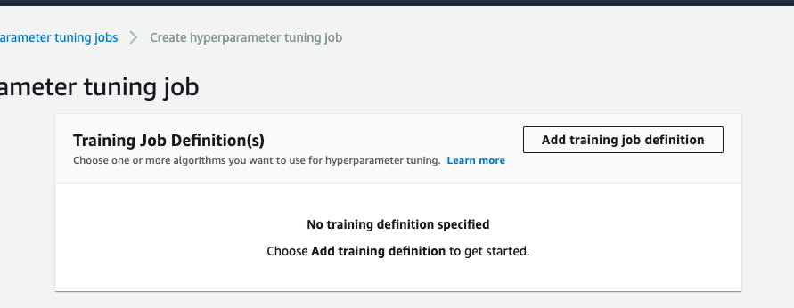
HYPERPARAMETERS OPTIMIZATION STEPS IN SAGEMAKER
Click on this to create a job

Slide 67
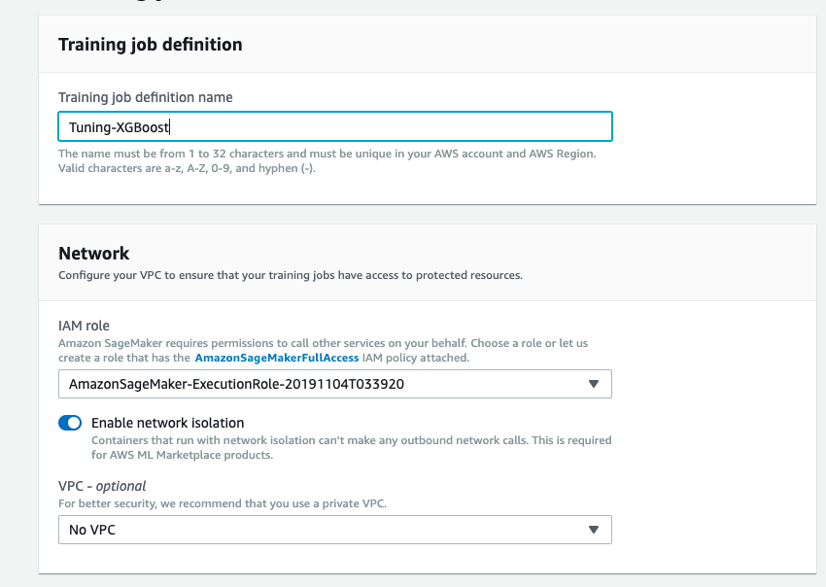
HYPERPARAMETERS OPTIMIZATION STEPS IN SAGEMAKER
Provide the name for training job
Select the IAM role that is used for your notebook instance.

Slide 68
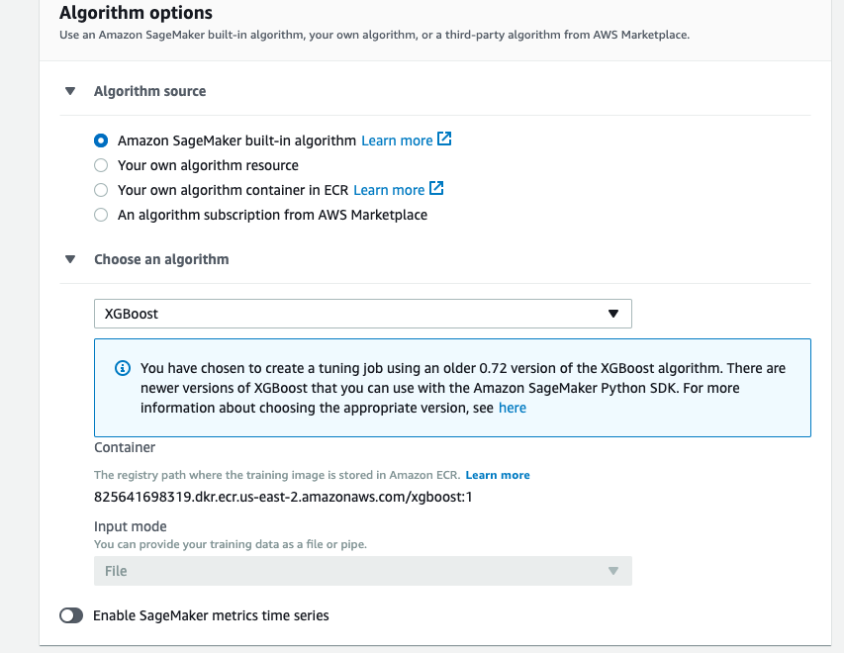
HYPERPARAMETERS OPTIMIZATION STEPS IN SAGEMAKER
Select the built-in algorithm
Select XGBoost from the drop-down menu

Slide 69
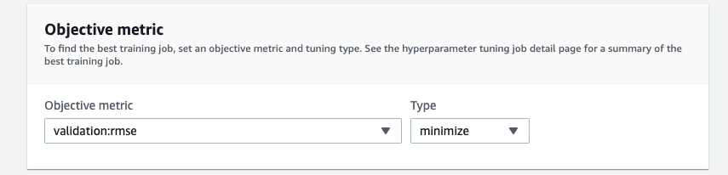
HYPERPARAMETERS OPTIMIZATION STEPS IN SAGEMAKER
Select validation:rmse from the drop-down menu and choose type minimize

Slide 70
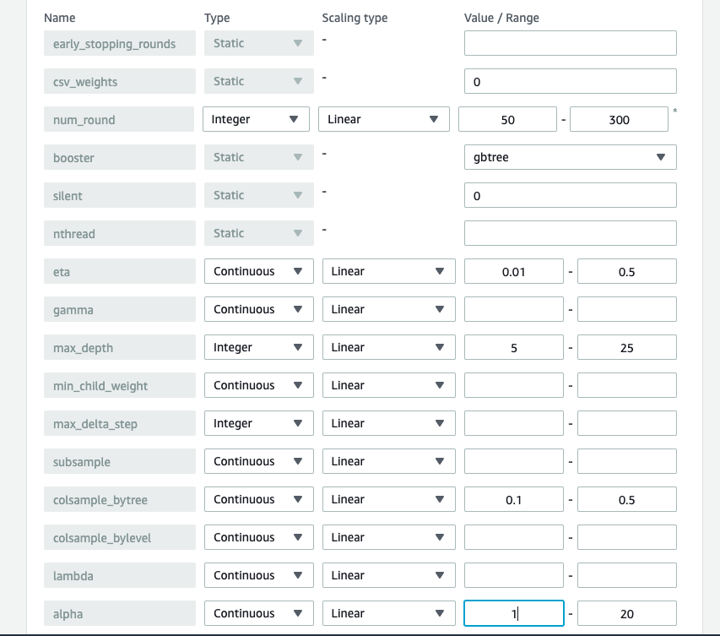
Image classifier
HYPERPARAMETERS OPTIMIZATION STEPS IN SAGEMAKER
Select the value range
Select the value range
Select the value range
Select the value range
Select the value range

Slide 71
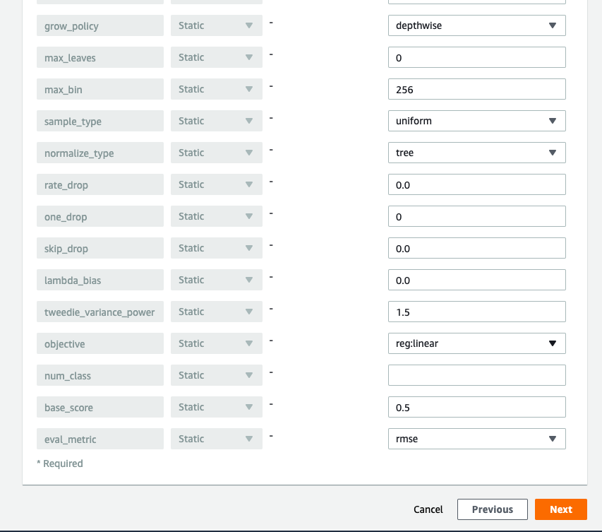
Image classifier
HYPERPARAMETERS OPTIMIZATION STEPS IN SAGEMAKER
Select rmse
Select next

Slide 72
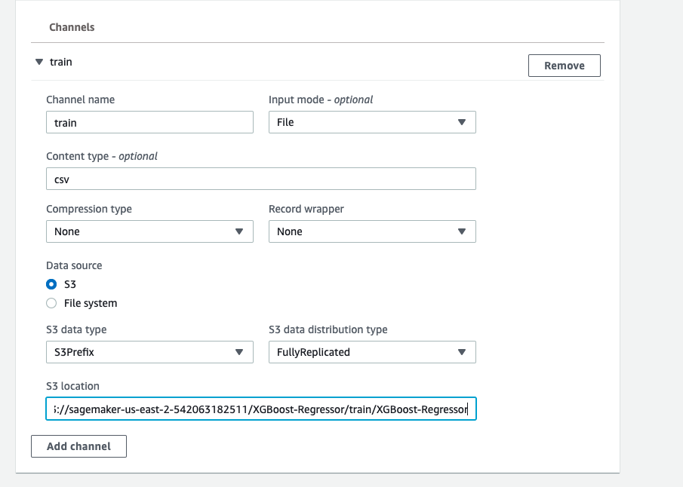
HYPERPARAMETERS OPTIMIZATION STEPS IN SAGEMAKER
Select file from the drop-down menu
Type in the channel name (train)
Mention the content type
Add the second channel
Provide the path of training data that is uploaded to S3

Slide 73
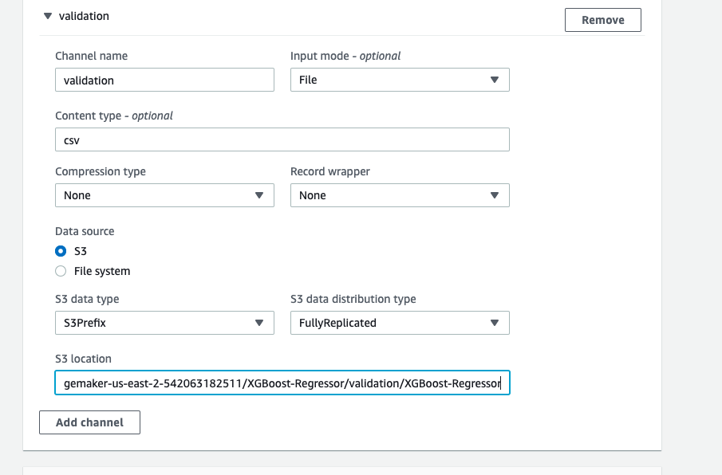
Image classifier
HYPERPARAMETERS OPTIMIZATION STEPS IN SAGEMAKER
Type in the channel name (validation)
Select file from the drop-down menu
Mention the content type
Provide the path of validation data that is uploaded to S3

Slide 74
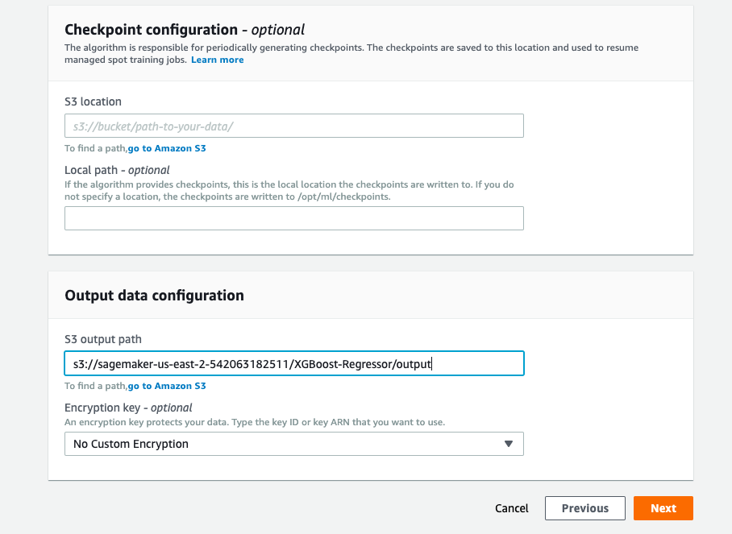
Image classifier
HYPERPARAMETERS OPTIMIZATION STEPS IN SAGEMAKER
Provide the S3 output path
Select next

Slide 75
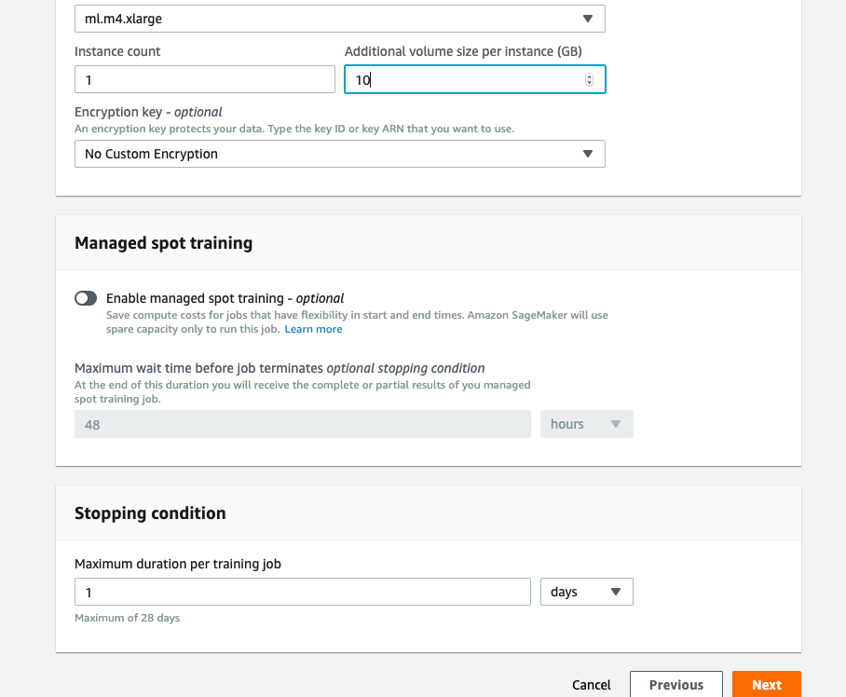
Image classifier
HYPERPARAMETERS OPTIMIZATION STEPS IN SAGEMAKER
Provide the volume size according to the size of dataset. We use 10 GB, as we have a small dataset.
Select Next

Slide 76
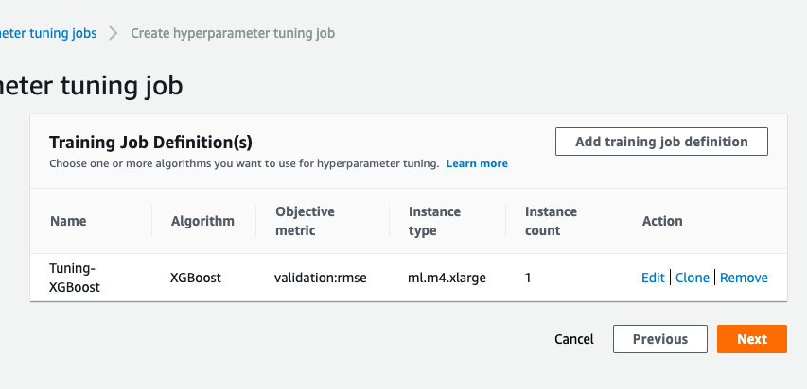
Image classifier
HYPERPARAMETERS OPTIMIZATION STEPS IN SAGEMAKER
Select Next

Slide 77
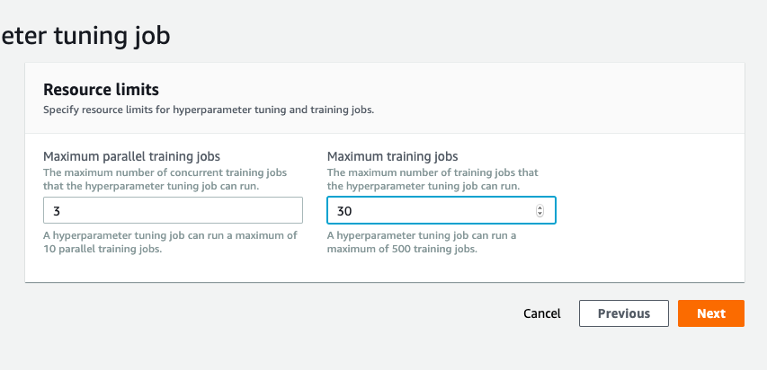
Image classifier
HYPERPARAMETERS OPTIMIZATION STEPS IN SAGEMAKER
Select Next
Select the number of jobs to be run in parallel.
Total number of training jobs to be performed

Slide 78
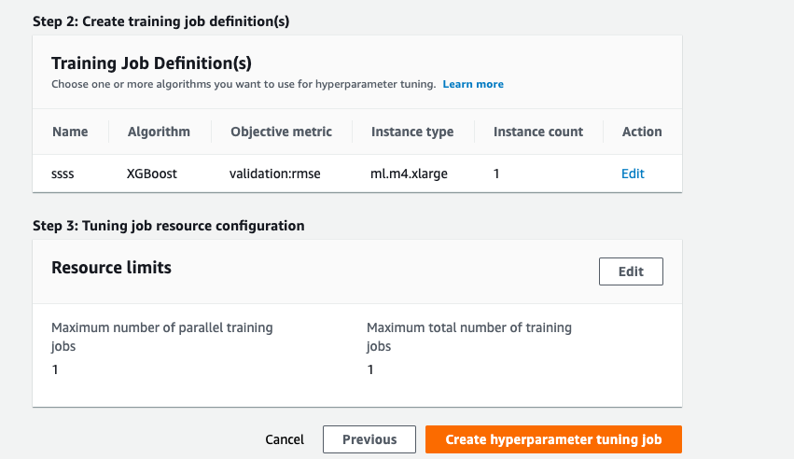
Image classifier
HYPERPARAMETERS OPTIMIZATION STEPS IN SAGEMAKER
Finally click this to create the tuning job

Slide 79
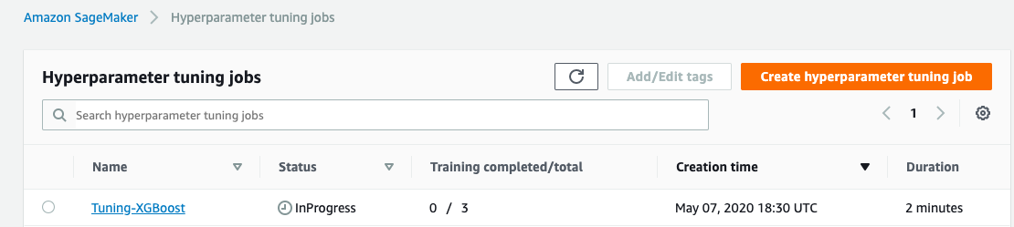
Image classifier
HYPERPARAMETERS OPTIMIZATION STEPS IN SAGEMAKER
Tuning job in progress

Slide 80

HYPERPARAMETERS OPTIMIZATION STEPS IN SAGEMAKER
After the completion, click this.

Slide 81
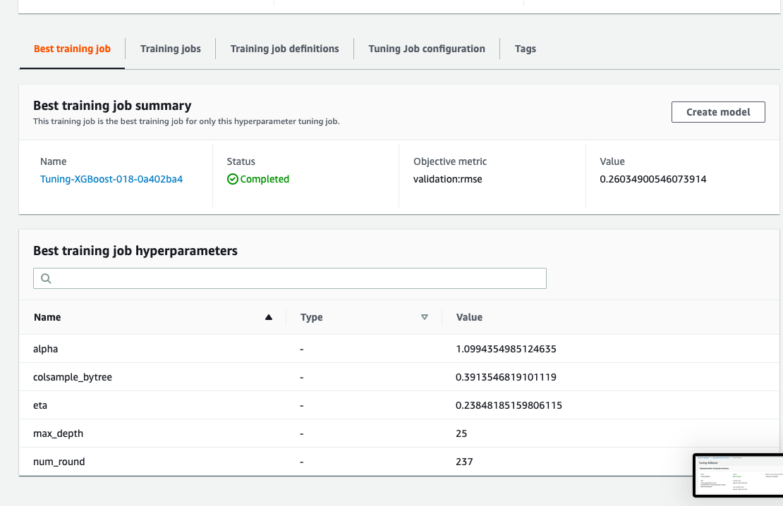
Image classifier
HYPERPARAMETERS OPTIMIZATION STEPS IN SAGEMAKER
You can scroll down to see the best training job hyper-parameters
Finally, you can copy these values to train your model in your notebook instance.

Slide 82
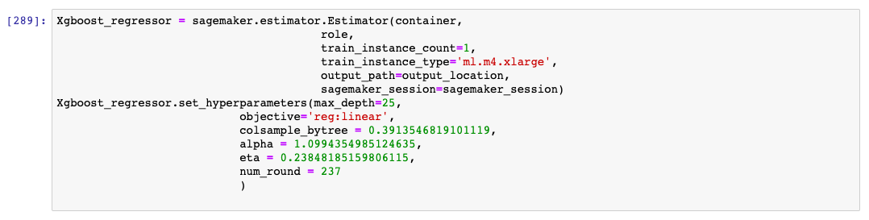
HYPERPARAMETERS OPTIMIZATION STEPS IN SAGEMAKER

Slide 83
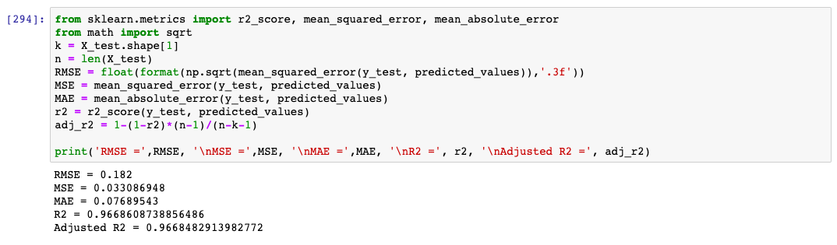
HYPERPARAMETERS OPTIMIZATION STEPS IN SAGEMAKER

